Slide 1

SUPER MARKET SHOP B2C SALES REPORT
PRESENTED BY
VAISHNAVI BHUJBAL.

Slide 2
AGENDA OF REPORT
INTRODUCTION
OBJECTIVE
ANALYSIS OF VISUAL
KAY BUSINESS QUESTIONS ANSWERED
SIGNIFICANCE OF VISUALS
INSIGHTS
CONCLUSION

Slide 3
Introduction
This Sales Dashboard Report provides an analysis of the supermarket's sales, profit, and performance metrics.
It highlights monthly and daily sales trends, top-performing products and categories, sales channels, and customer payment preferences.
The goal is to deliver actionable insights for improving revenue, optimizing operations, and identifying growth opportunities.
By focusing on data-driven analysis, the report helps evaluate business performance and guide strategic decision-making for sustainable success.

Slide 4
Objective
The objective of this project is to analyze sales and profitability data to:
Identify trends in monthly and daily sales.
Highlight top-performing products and categories.
Evaluate the performance of sales channels and payment modes.
Provide actionable insights to optimize revenue and business operations.

Slide 5
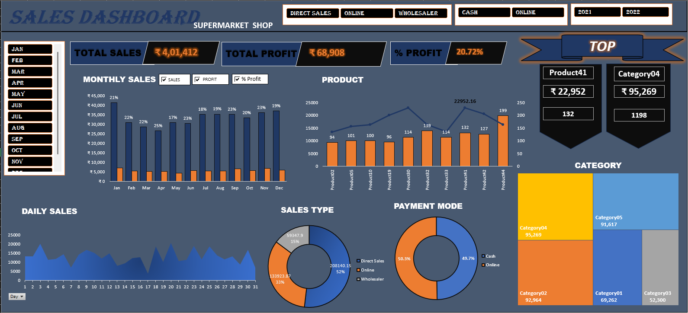
COMPLETE DASHBOARD
B2C SALES REPORT

Slide 6
Analysis of Visual Key Business Questions Answered Significance of Visuals
NEXT SLIDES WITH VISUALS SHOW THE ABOVE POINTS :

Slide 7



1. Total Sales, Profit, and Profit Percentage
What It Shows: Provides an overview of the business's performance with ₹4,01,412 in total sales, ₹68,908 in profit, and a profit margin of 20.72%.
Why It’s Used: Helps understand overall profitability and performance at a glance.
Business Questions Solved:
How much revenue and profit did the store generate?
What is the profit margin?
Chart Type: Numeric summary boxes are used for clarity and quick reference

Slide 8
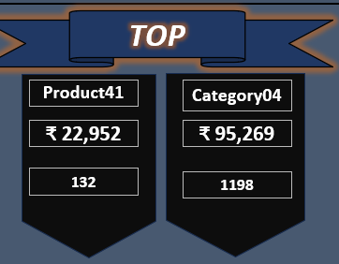
2. Top Product and Category (Summary Boxes)
What It Shows: Displays the top-performing product (Product41) and category (Category04), along with their sales figures.
Why It’s Used: Quickly identifies the highest revenue generators.
Business Questions Solved:
What are the best-performing products and categories?
How much revenue do they generate?
Chart Type: Summary boxes provide concise, key metrics for quick reference.

Slide 9
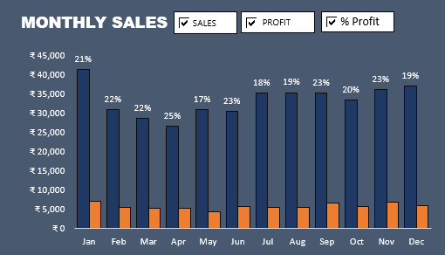
3. Monthly Sales & Profit (Stacked column )
What It Shows: Monthly breakdown of sales and profit trends.
Sales and profit are shown with bars, and profit percentage is shown as data labels .
Why It’s Used: Identifies the peak-performing months and seasonal trends.
Business Questions Solved: When are the sales and profits the highest or lowest? How does seasonality affect the business?

Slide 10
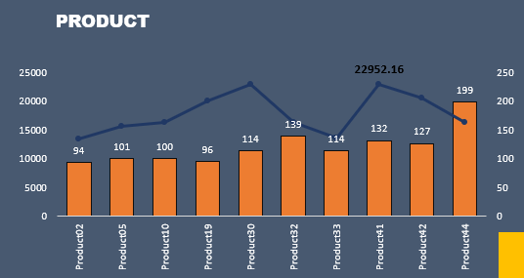
4. Product Performance (Bar and Line Chart)
What It Shows: Sales volume (bar) and revenue (line) for individual products.
Why It’s Used: Highlights the best and worst-performing products.
Business Questions Solved:
Which products contribute the most to sales and revenue?
Are certain products underperforming?
Chart Type: Bar and line combination effectively compares volume and revenue performance for individual products.

Slide 11
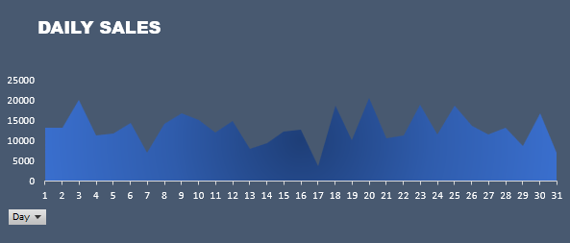
5. Daily Sales (Line Chart)
What It Shows: Day-wise sales performance for the month.
Why It’s Used: Tracks daily fluctuations and helps identify consistent or peak-performing days.
Business Questions Solved:
Are there specific days with higher sales?
What are the sales patterns across days in a month?
Chart Type: Line chart is ideal for tracking trends and changes over continuous data (daily).

Slide 12
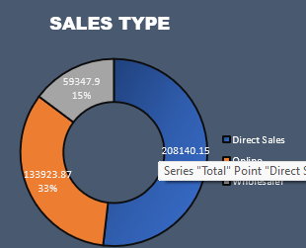
6. Sales Type (Doughnut Chart)
What It Shows: Distribution of sales across Direct, Online, and Wholesale type.
Why It’s Used: Highlights which sales type contribute the most to overall revenue.
Business Questions Solved:
What is the contribution of each sales type?
Which type should be prioritized for growth?
Chart Type: Doughnut chart is suitable for showing proportional contributions.

Slide 13
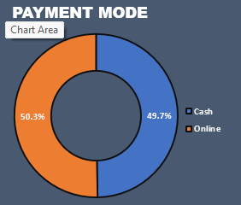
7. Payment Mode (Pie Chart)
What It Shows: Distribution of payments between cash and online modes.
Why It’s Used: Helps assess customer payment preferences.
Business Questions Solved:
What percentage of customers prefer cash vs.
online payments?
Should efforts be made to promote digital payments?
Chart Type: Doughnut chart simplifies the representation of two categories for comparison.

Slide 14
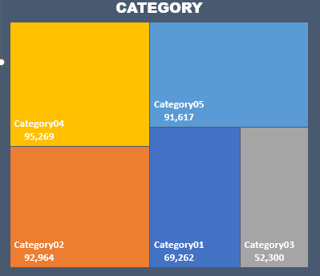
8. Category –Wise Sales (Tree Map)
What It Shows: Sales distribution across different categories, with larger sections representing higher sales.
Why It’s Used: Provides a visual breakdown of category contributions to total sales.
Business Questions Solved:
Which categories generate the most sales?
How balanced is the sales distribution
across categories?
Chart Type: Tree map effectively shows proportional data in a visually intuitive format.

Slide 15
INSIGHTS
Sales peaked during specific months like January, August, and November, showing seasonality.
Product41 and Category04 are top performers, contributing significantly to revenue.
Direct sales dominate (52%), followed by wholesale (33%) and online sales (15%).
Payment preferences are nearly equal between cash and online, indicating diverse customer behaviors.
Category04 and Category05 generate the most revenue, while others show room for improvement.

Slide 16
CONCLUSION
This dashboard provides a detailed analysis of monthly and daily sales trends, product and category performance, sales channel efficiency, and payment mode preferences.
The insights can be used to enhance product strategies, optimize underperforming categories, and strengthen sales channels.
By leveraging these findings, the business can improve profitability and align operations with customer preferences.

Slide 17
Thank you

